Slide 1
BCD Adder

Slide 2
BCD Adder
A BCD adder is a circuit that adds two BCD digits in Parallel and produces a sum digital also in BCD.
A BCD adder must include the correction logic in its internal construction.
A decimal parallel adder that adds n decimal digits need n BCD adder stages.
Output carry from one stage must be connected to the input carry of the next higher order stage.

Slide 3
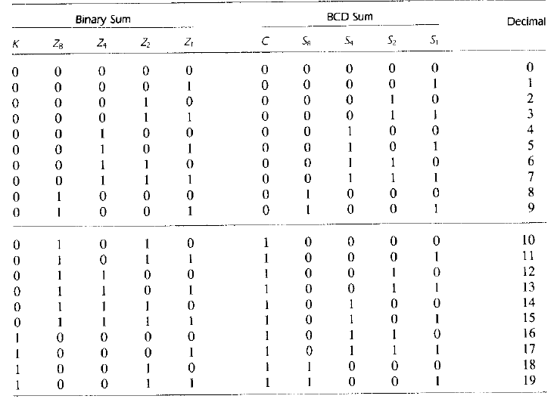
BCD Adder

Slide 4
BCD Adder
Z₄Z₂Z₁
KZ₈
000 001 011 010 110 111 101 100
00
01
11
10
0 | 1 | 3 | 2 | 6 | 7 | 5 | 4
8 | 9 | 11 | 10 | 14 | 15 | 13 | 12
24 | 25 | 27 | 26 | 30 | 31 | 29 | 28
16 | 17 | 19 | 18 | 22 | 23 | 21 | 20
1
1
1
1
1
1
X
X
X
X
X
X
X
X
1
1
1
1
X
X
X
X
C = K + Z₈Z₄ + Z₈Z₂

Slide 5
Block Diagram of a BCD adder

